Slide 1
Data Structure
Soumi Dutta, IEM

Slide 2
SEARCHING
Searching is a process of checking and finding an element from a list of elements. There are several types of searching techniques;
1. Linear or Sequential Search
2. Binary Search
3. Interpolation Search

Slide 3
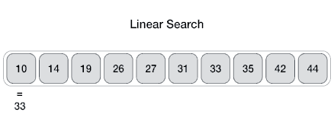
LINEAR OR SEQUENTIAL SEARCH
In linear search, each element of an array is read one by one sequentially and it is compared with the desired element. A search will be unsuccessful if all the elements are read and the desired element is not found.
Search Item 33:

Slide 4
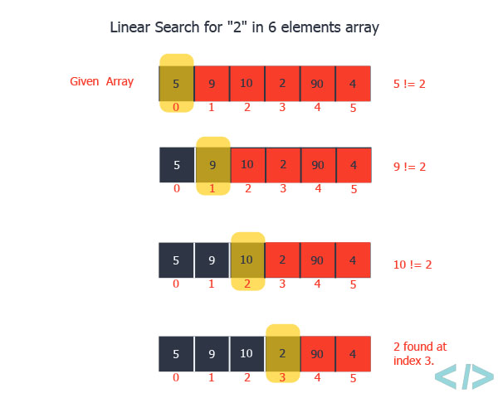
Example

Slide 5
ALGORITHM FOR LINEAR SEARCH
Let A be an array of n elements, A[0],A[1],A[2],A[3], ...... A[n-1]. “data” is the element to be searched. Then this algorithm will find the location “loc” of data in A. Set loc = – 1,if the search is unsuccessful.
1. Input an array A of n elements and “data” to be searched and initialize loc = – 1.
2. Initialize i = 0; and repeat through step 3 if (i < n) by incrementing i by one .
3. If (data == A[i])
  (a) loc = i, Display “data is found and searching is successful”
  (b) Break
4. If (loc ==-1) then
(a) Display “data is not found and searching is unsuccessful”
6. Exit

Slide 6
CODE FOR LINEAR SEARCH
#include <stdio.h>
int main() {
int array[100], search, c, n, loc=-1;
printf("Enter number of elements in array\n");
scanf("%d", &n);
printf("Enter %d integer(s)\n", n);
for (c = 0; c < n; c++)
scanf("%d", &array[c]);
printf("Enter a number to search\n");
scanf("%d", &search);
for (c = 0; c < n; c++) {
if (array[c] == search) {
printf("%d is present at location %d.\n", search, c+1);
loc=c;
break;
} }
if (loc==-1)
printf("%d isn't present in the array.\n", search);
return 0; }
Input of Array
Input the search item
If required element is found
If required element is not found

Slide 7
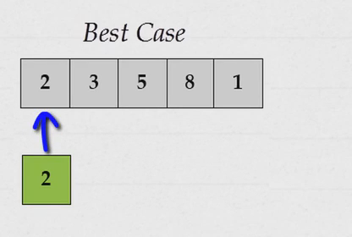
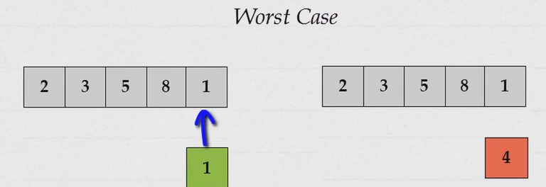
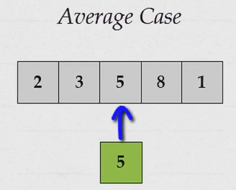
TIME COMPLEXITY
Time Complexity of the linear search is found by number of comparisons made in searching a record.
In the best case, the desired element is present in the first position of the array, i.e., only one comparison is made. So f (n) = O(1).
But in the worst case the desired element is present in the nth (or last) position of the array, so n comparisons are made. So f (n) = O(n ).
In the Average case, the desired element is found in the half position of the array, then
f (n) = O(n /2).

Slide 8
BINARY SEARCH
Binary search is an extremely efficient algorithm when it is compared to linear search. In Binary search the given array is a sorted one, otherwise first we have to sort the array elements.
Then apply the following conditions to search a “data”.
Find the middle element of the array (i.e., n/2 is the middle element if the array or the sub-array contains n elements).
Compare the middle element with the data to be searched, then there are following three cases.
  (a) If it is a desired element, then search is successful.
  (b) If it is less than desired data, then search only the first half of the array, i.e., the elements which come to the left side of the middle element.
  (c) If it is greater than the desired data, then search only the second half of the array, i.e., the elements which come to the right side of the middle element. Repeat the same steps until an element is found or exhaust the search area.

Slide 9
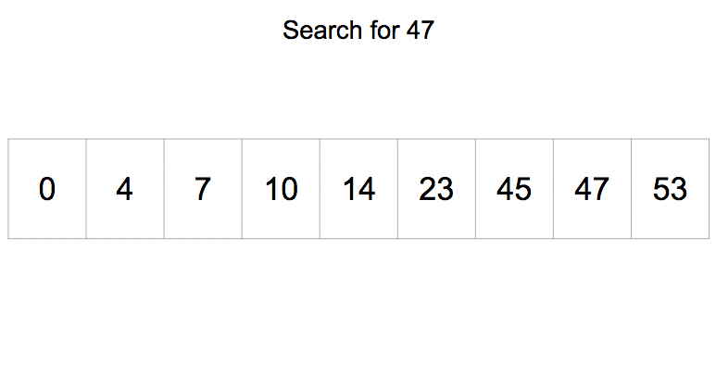
BINARY SEARCH EXAMPLE

Slide 10
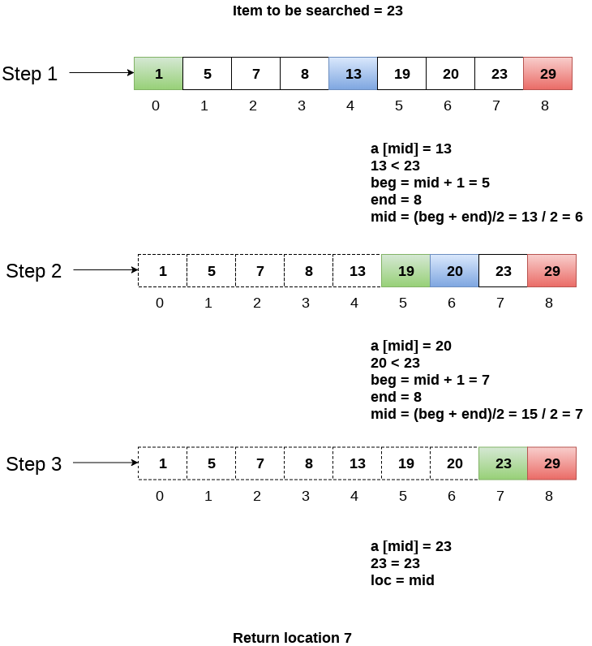
Example of BINARY SEARCH

Slide 11
ALGORITHM FOR BINARY SEARCH
Let A be an array of n elements A[0],A[1],A[2],A[3],...... A[n-1]. “Data” is an element to be searched. “mid” denotes the middle location of a segment (or array or sub-array) of the element of A. LB and UB is the lower and upper bound of the array which is under consideration.
1. Input an array A of n elements and “data” to be sorted, loc=-1
2. LB = 0, UB = n-1; mid = int ((LB+UB)/2)
3. Repeat step 4 and 7 while (LB <= UB)
  4. If (A[mid]== data)
    Display “the data found”
    loc=mid
  5. If (data < A[mid])
    (a) UB = mid–1
  6. Else
    (a) LB = mid + 1
  7. Mid = int ((LB + UB)/2)
8. If (loc==-1)
(a) Display “the data is not found”
9. Exit

Slide 12
CODE FOR BINARY SEARCH
#include <stdio.h>
int main() {
int c, first, last, middle, n, search, array[100], loc=-1;
printf("Enter number of elements\n");
scanf("%d",&n);
printf("Enter %d integers\n", n);
for (c = 0; c < n; c++)
scanf("%d",&array[c]);
printf("Enter value to find\n");
scanf("%d", &search);
first = 0;
last = n - 1;
middle = (first+last)/2;
Input of Array
Input the search item
Mid value calculation

Slide 13
while (first <= last) {
if (array[middle] == search) {
printf("%d found at location %d.\n", search, middle+1);
loc=middle;
break;
}
else if (array[middle] < search)
first = middle + 1;
else
last = middle - 1;
middle = (first + last)/2;
}
if (loc==-1)
printf("Not found! %d isn't present in the list.\n", search);
return 0;
}
search item match with mid element
search item greater than mid element
search item less than mid element
Update mid value

Slide 14
TIME COMPLEXITY
Time Complexity is measured by the number f (n) of comparisons to locate “data” in A, which contain n elements. Observe that in each comparison the size of the search area is reduced by half. So complexity is logarithmic.
Best case - O (1) comparisons; In the best case, the item X is the middle in the array A. A constant number of comparisons (actually just 1) are required.
Worst case - O (log n) comparisons; In the worst case, the item X does not exist in the array A at all. Hence in the worst case, at most log2 n comparisons required. So f (n) = O([log2 n ]).
Average case - O (log n) comparisons; Time Complexity in the average case is almost approximately equal to the running time of the worst case.

Slide 15
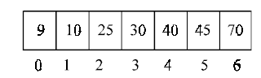
TIME COMPLEXITY
Height of tree= 3
For m number comparison m+1 elements are required.
3
1
5
0
2
4
6
Mid Values

Slide 16
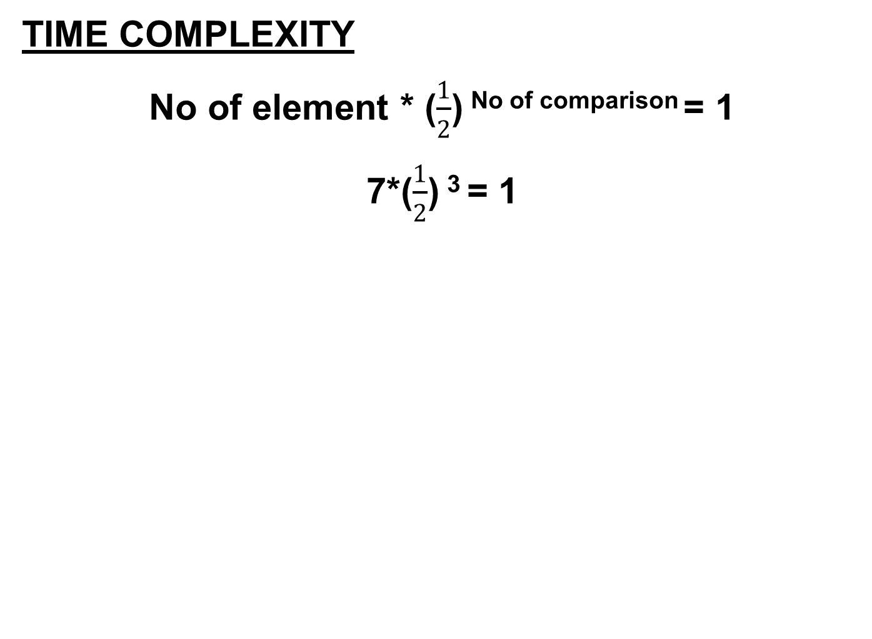
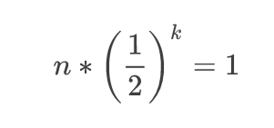
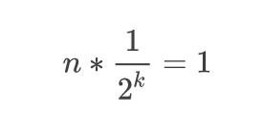
Generalization
Separating the power for the numerator and denominator

Slide 17
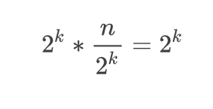
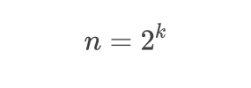

TIME COMPLEXITY
Multiplying both sides by 2^k
Final result
Logarithmic form
k = log₂ n

Slide 18
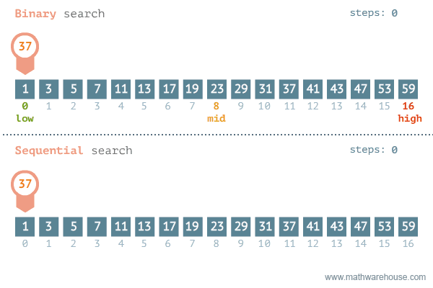
Comparision

Slide 19
INTERPOLATION SEARCH
Another technique for searching an ordered array is called interpolation search. This method is even more efficient than binary search, if the elements are uniformly distributed (or sorted) in an array A.
Consider an array A of n elements and the elements are uniformly distributed (or the elements are arranged in a sorted array). Initially, as in binary search, low is set to 0 and high is set to n – 1.
Now we are searching an element key in an array between A[low] and A[high]. The key would be expected to be at mid, which is an approximately position.
mid = low + (high – low) × ((key – A[low])/(A[high] – A[low]))
If key is lower than A[mid], reset high to mid–1; else reset low to mid+1. Repeat the process until the key has found or low > high.

Slide 20
Example
Interpolation search can be explained with an example below. Consider 7 numbers :
2, 25, 35, 39, 40, 47, 50
CASE 1: Say we are searching 50 from the array
    Here n = 7 Key = 50
    low = 0
    high = n – 1 = 6
    mid = 0+(6–0) × ((50–2)/(50–2))
    = 6 × (48/48)
    = 6
    if (key == A[mid])
    ⇒ key == A[6]
    ⇒ 50 == 50
    ⇒ key is found.

Slide 21
CASE 2: Say we are searching 25 from the array
      Here n = 7 Key = 25
      low = 0
      high = n – 1 = 6
      mid = 0 + (6–0) × ((25–2)/(50–2))
      = 6 × (23/48)
      = 2.875 Here we consider only the integer part of the mid
      i.e., mid = 2
      if (key == A[mid])
      ⇒ key == A[2]
      ⇒ 25 == 25
      ⇒ key is found.

Slide 22
CASE 3: Say we are searching 34 from the array
    Here n = 7 Key = 34
    low = 0
    high = n – 1 = 6
    mid = 0 + (6 – 0) × ((34 – 2)/(34 – 2))
    = 6 × (32/48)
    = 4
    if(key < A[mid])
    ⇒ key < A[4]
    ⇒ 34 < 40
    so reset high = mid–1
    ⇒ 3
    low = 0
    high = 3
    Since(low < high)
    mid = 0+(3–0) × ((34–2)/(39–2))
    = 3 × (32/37)
    = 2.59 Here we consider only the integer part of the mid
    i.e., mid = 2

Slide 23
if (key < A[mid])
⇒ key < A[2]
⇒ 34 < 35
so reset high = mid–1
⇒ 1
low = 0
high = 1
Since (low < high)
mid = 0+(1–0) × ((34–2)/(25–2))
= 3 × (32/23)
= 1
here (key > A[mid])
⇒ key > A[1]
⇒ 34 > 25
so reset low = mid+1
⇒ 2
low = 2
high = 1
Since (low > high)
DISPLAY “ The key is not in the array”
STOP

Slide 24
Algorithm
Suppose A be array of sorted elements and key is the elements to be searched and low represents the lower bound of the array and high represents higher bound of the array.
1. Input a sorted array of n elements and the key to be searched
2. Initialize low = 0 and high = n – 1
3. Repeat the steps 4 through 7 until if(low < high)
4. Mid = low + (high – low) × ((key – A[low]) / (A[high] – A[low]))
5. If(key < A[mid])
  (a) high = mid–1
6. Else if (key > A[mid])
  (a) low = mid + 1
7. Else
  (a) DISPLAY “ The key is not in the array”
  (b) STOP
8. STOP
Time Complexity :
If elements are uniformly distributed, then O (log log n)). In worst case it can take upto O(n). Auxiliary Space : O(1).

Slide 25
Advantages
If the items are uniformly distributed, the average case time complexity is log₂(log₂(n)).
It is considered improvement in binary search.
Disadvantages:
The calculation of mid is complicated. It increases the execution time.
If the items are not uniformly distributed, interpolation search will have very poor behavior.
Difference between Linear Search and Binary Search
Linear Search | Binary Search
Sorted list is not required. | Sorted list is required.
It can be used in linked list implementation. | It cannot be used in liked list implementation.
It is suitable for a list changing very frequently. | It is only suitable for static lists, because any change requires resorting of the list.
The average number of comparison is very high. | The average number of comparison is relatively slow.

